Slide 2


N = 24 healthy participants
N = 24 PTSD symptom individuals
Pre-acquisition baseline
Pre-acquisition baseline
Acquisition
Extinction
24 hr break
Recognition memory test
Fear renewal test
Recognition memory test
Perceptual localizer
Dissociable neural reinstatement of emotional memories in human PFC

Slide 3
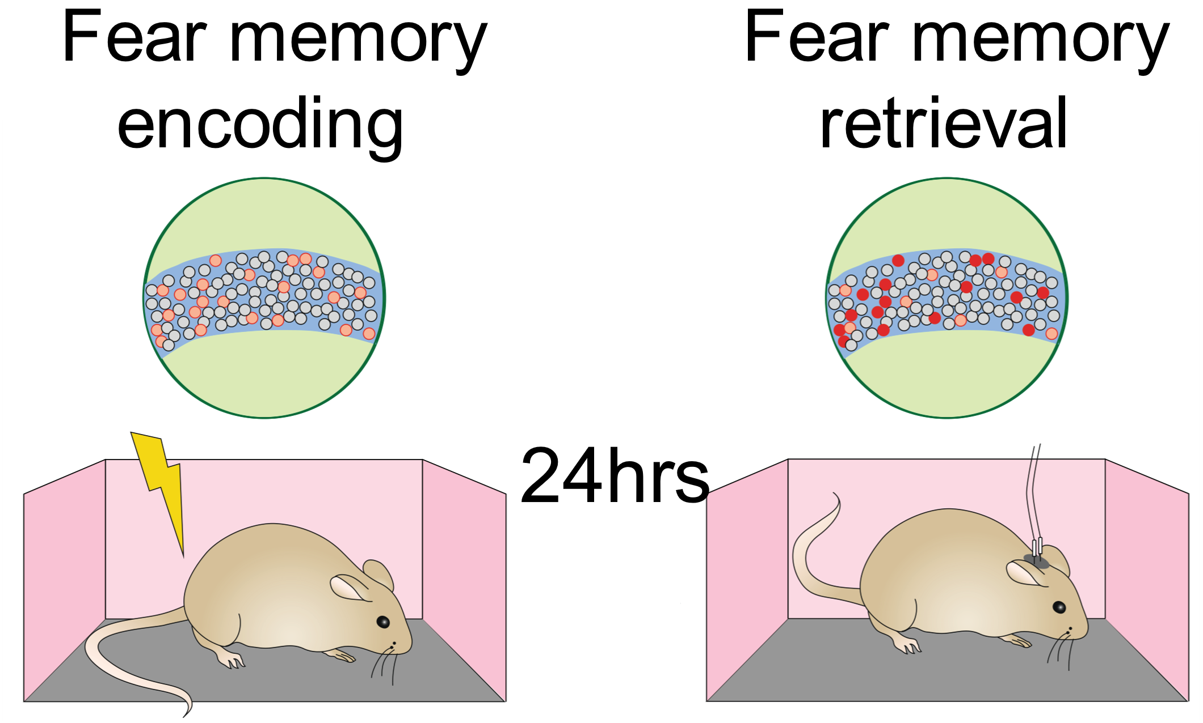
The neural circuits which encode a memory reactivate during retrieval
Fear and extinction engrams are stable and separable, in rodents
Strength of reactivation predicts behavior
Dissociable neural reinstatement of emotional memories in human PFC
Frankland et al., 2019 Nat Neurosci

Slide 4
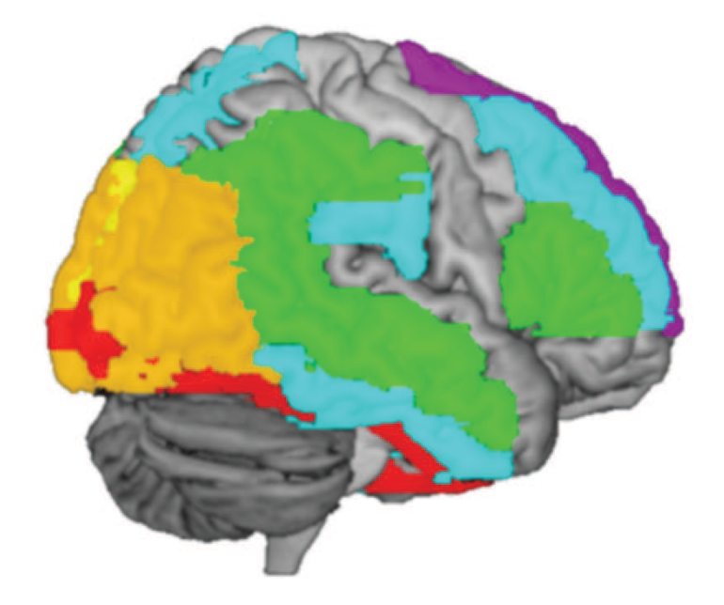
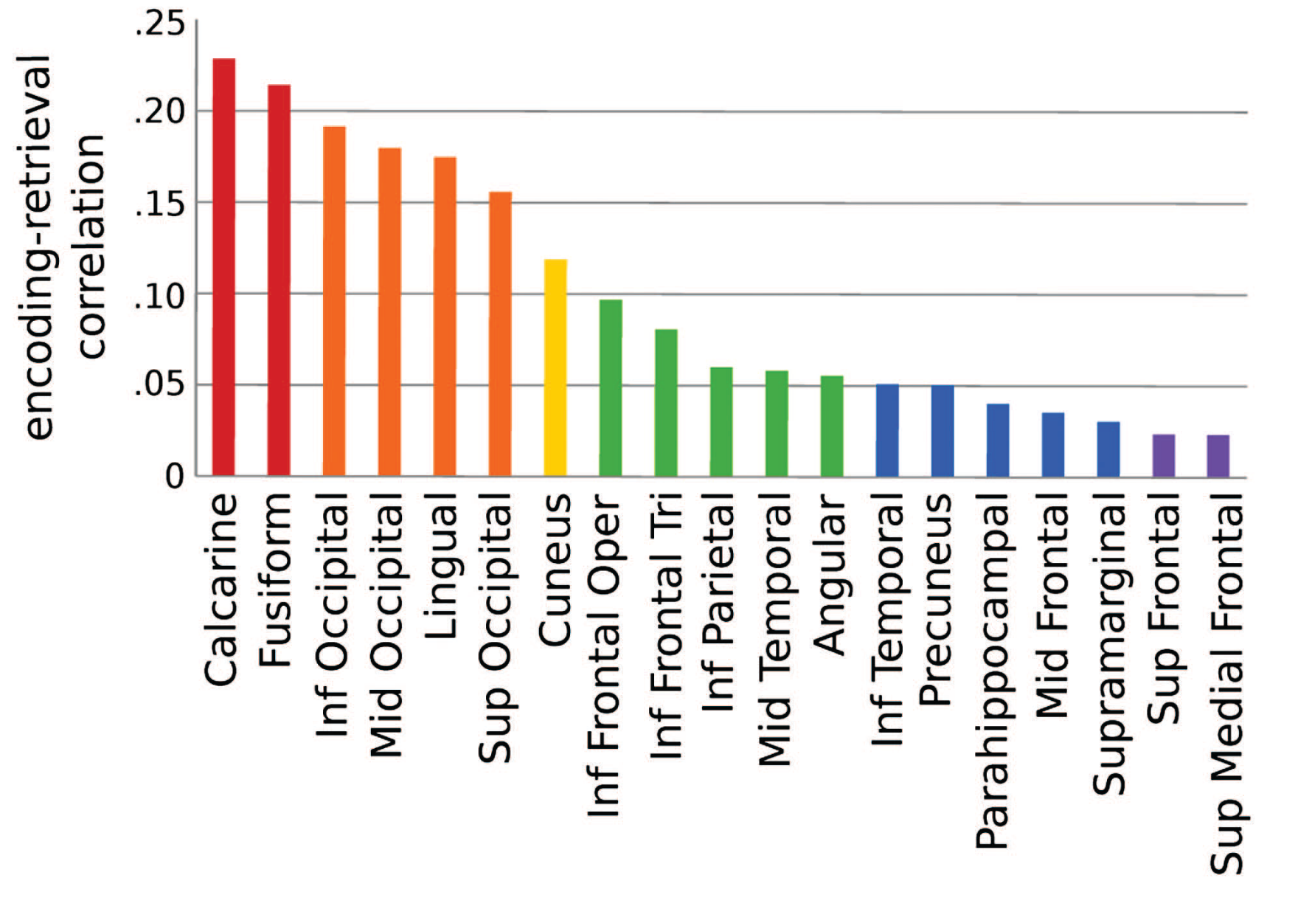
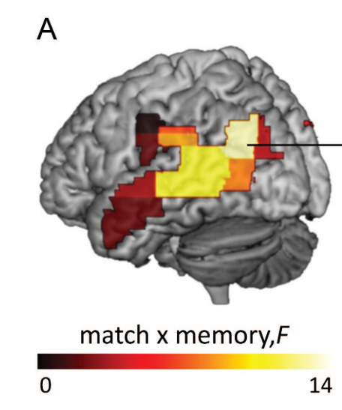
Encoding Retrieval Similarity (ERS) Measure overlap of neural activity from encoding to retrieval
Item-level reactivation in cortex
Item-level reactivation predicts memory
Ritchey et al., 2019 Cereb Cortex

Slide 5
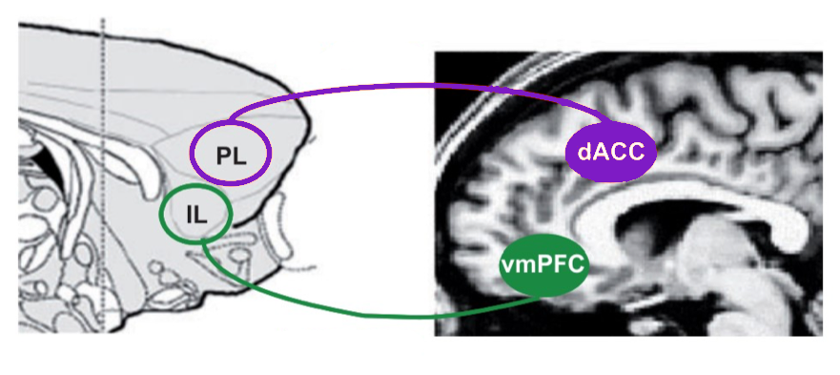


Prelimbic and infralimbic code for memories of opposite valence
PL = Fear Acquisition
IL = Extinction
Milad & Quirk, 2012, Annu Rev Psychol

Slide 6
Is reinstatement dysregulated in individuals with PTSD?
Are associative emotional memories organized the same way in the humans as in rodents?
-Goal-
Identify stable & separable representations of acquisition and extinction across the PFC

Slide 7






Category conditioning
Dunsmoor & Kroes, 2019, Curr Opin Behav Sci
Surprise Recognition
Memory Test
Each unique episodic memory item is encoded with one emotional association
Def Old
Def New
Baseline
Maybe Old
Maybe New
Acquisition
Extinction
CS+, Animals
CS-
CS+
CS-, Tools
…
CS+
…
CS-
…
Specific category exemplars are never repeated

Slide 8
Encoding Phase
Emotional Valence
Baseline
CS+
Acquisition
CS-
Surprise Recognition
Memory Test
Early Extinction
Extinction
Late Extinction
ERS = pearson’s r (encoding, retrieval)
Def Old
Def New
Maybe Old
Maybe New
Emotional selectivity = CS+_{ERS} – CS-_{ERS}

Slide 9


Brainnetome atlas – fine grained parcellation of cortex
11 bilateral ROIs from frontal & limbic lobes, along the midline
x = 3

Slide 10
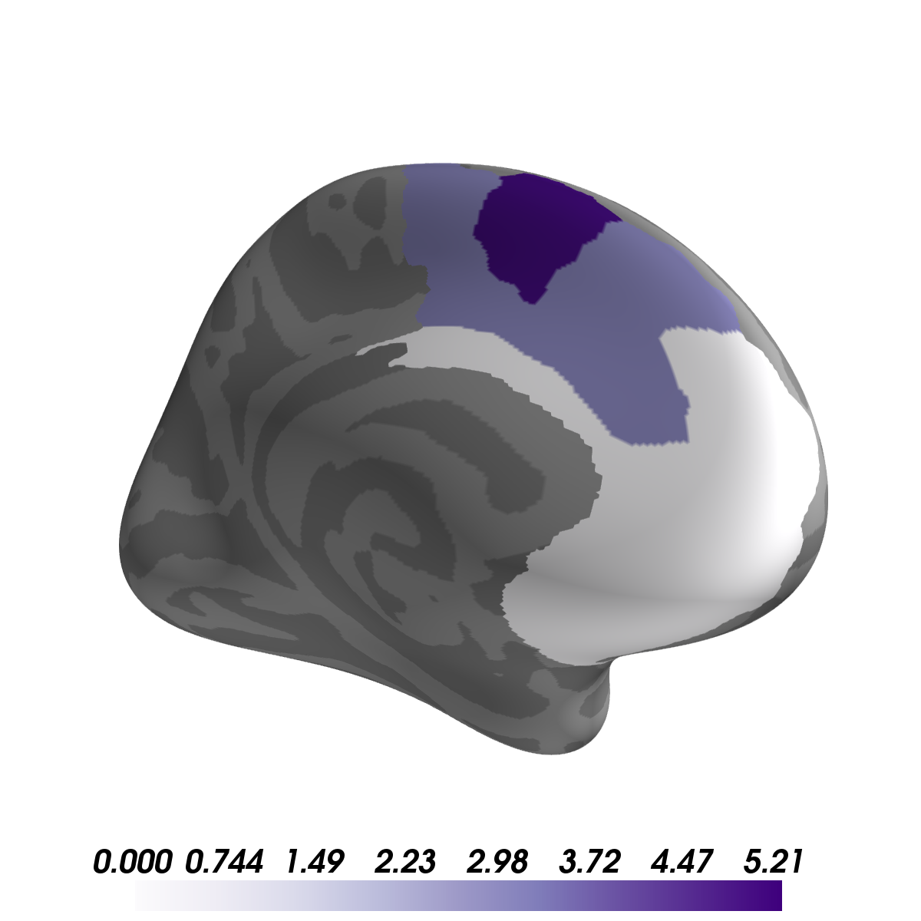
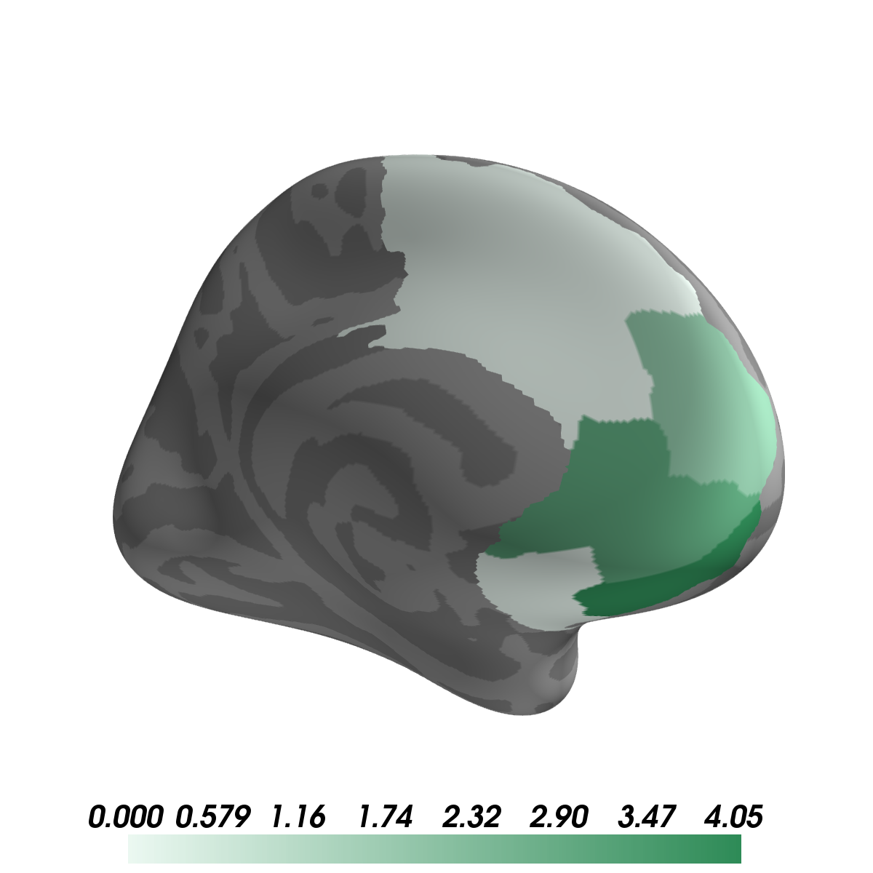
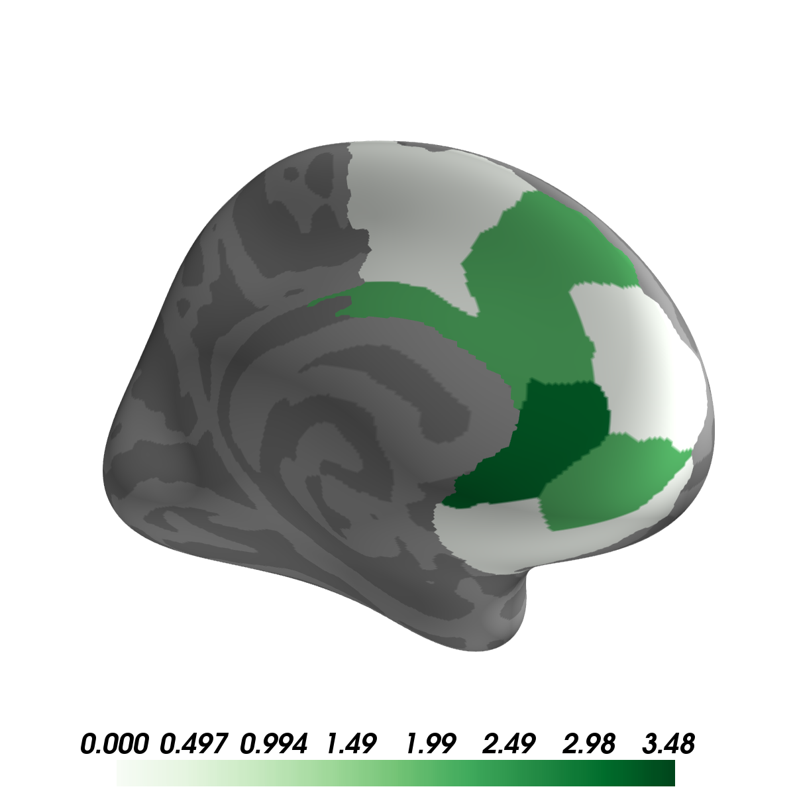
Healthy
Acquisition
Early Extinction
Late Extinction
No significant emotional ERS for items encoded during Baseline
t-stats are 1 sided CS+_{ERS} > CS-_{ERS}
Each image threshold at p<.05 FDR corrected

Slide 11
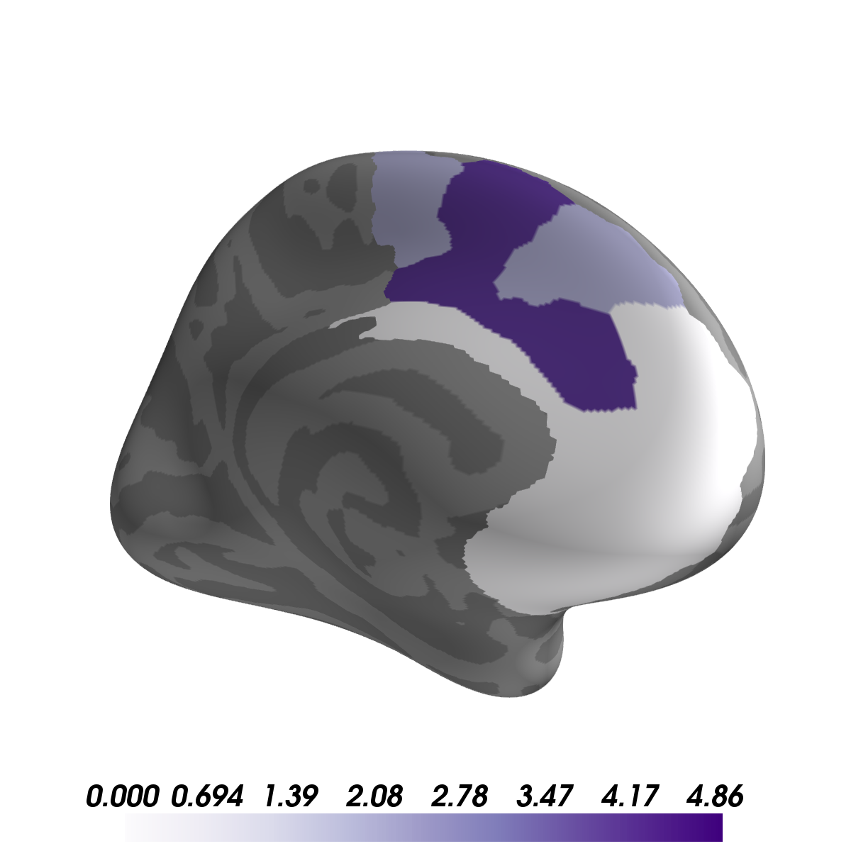
Healthy
PTSD
No significant emotional ERS for items encoded during Baseline
No significant emotional ERS for items encoded during Early or Late Extinction
t-stats are 1 sided CS+_{ERS} > CS-_{ERS}
Each image threshold at p<.05 FDR corrected

Slide 12
Healthy
PTSD
Dissociable reinstatement in PFC of
emotional memories in healthy adults
Individuals with PTSD misallocate do not reinstate extinction memories
Relating ERS to behavior
Functional connectivity with sub-cortical ROIs

